Slide 1

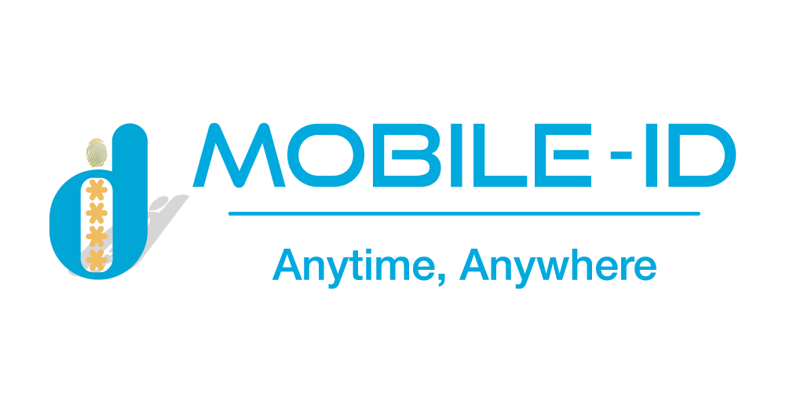

OVERVIEW
GOPAPERLESS
Online identity verification and signing platform with full optimal features

Slide 2




CONTENTS
GOPAPERLESS SYSTEM OVERVIEW
GOPAPERLESS SUBSYSTEM

Slide 3

INTRODUCTION
PURPOSE
OVERVIEW
To save time, and costs, increase the ability to manage, store, and secure information, digital transformation is indispensable and “Electronic identity” is also a necessary need today.
It can be seen that to sign a contract, financial report, etc., verifying personal identity and legal signature using a manual process will require many procedures, time and cost. From the above issue, the GoPaperless electronic identification and signing platform was born.
Create an online signing and verifying identity platform with all of the optimal features, specifically:
GOPAPERLESS SYSTEM
Enables quick, efficient online approval of any business document, agreement, report, request, or package;
Cuts time, reduces costs and adds strong controls to minimize signing errors;
Ensure traceability, accountability and audit with clear legal weight, data integrity and individual signed approval together with easy to access workflow process evidence;
Can be shared, viewed, and signed on any device, anywhere, anytime in a way that suits any approval process.

Slide 4


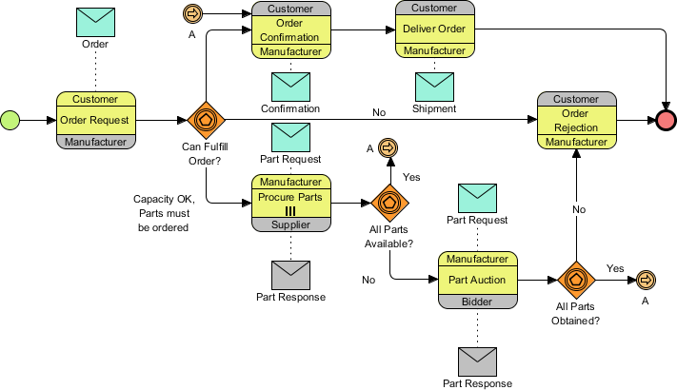
OVERVIEW
GOPAPERLESS SYSTEM ARCHITECTER
External System
Bank, judicial, etc.
Business
Mobile-ID’s Internal System
CUSTOMER
eTax, eContract, eInvoice, Qrypto, CheckID, eKYC, etc.
Personal
Mobile-ID’s staff
Sales, Admin, customer support staff, etc.

Slide 5






IDENTIFICATION
PLATFORM
PERSONAL IDENTITY
BUSINESS IDENTITY
STEP 1
STEP 2
STEP 3
Face authentication
4 factors authentication
via Finance
3 factors authentication
via service provider
Verify business
Representative information
Check company
information
Authorization
authentication
Check Liveness
Compare with portrait photo
Compare with Citizen Identity cards
Verify national data
Check full name
Check ID Card/ Citizen ID card number Check financial status
Check taxpayer status
Check full name
Check ID Card/ Citizen ID card number
Check phone number
Face authentication
4 factors authentication via finance
3 factors authentication via service provider
Company’s name
Company registration certificate number
Information on company status
Authorization legal representation
Sesame enterprise certification?
Deposit money into company account?

Slide 6

FULL PROCESS SIGNING PLATFORM
Service Provider
Signer
Verify identity
Confirm contract
Sign
Digital
contact
Authenticate
Manage contact
Electronic deposit
Legal service
Verify individuals
Verify enterprise
Ensure the accuracy of identity information by using services such as eKYC, OTP, etc.
Sign: Ensure the signer’s wishes via letter of commitment, confirmation
Deploy electronic contract on industries ecosystem platform: Banking, Electronic Commercial, Real Estate, Automotive, etc.
Template of contract, condition Monitor contract
Provide deposit, certificate of deposit service Notarize, authenticate contract

Slide 7

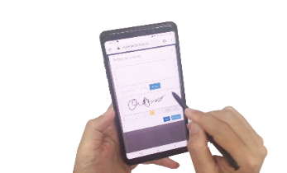

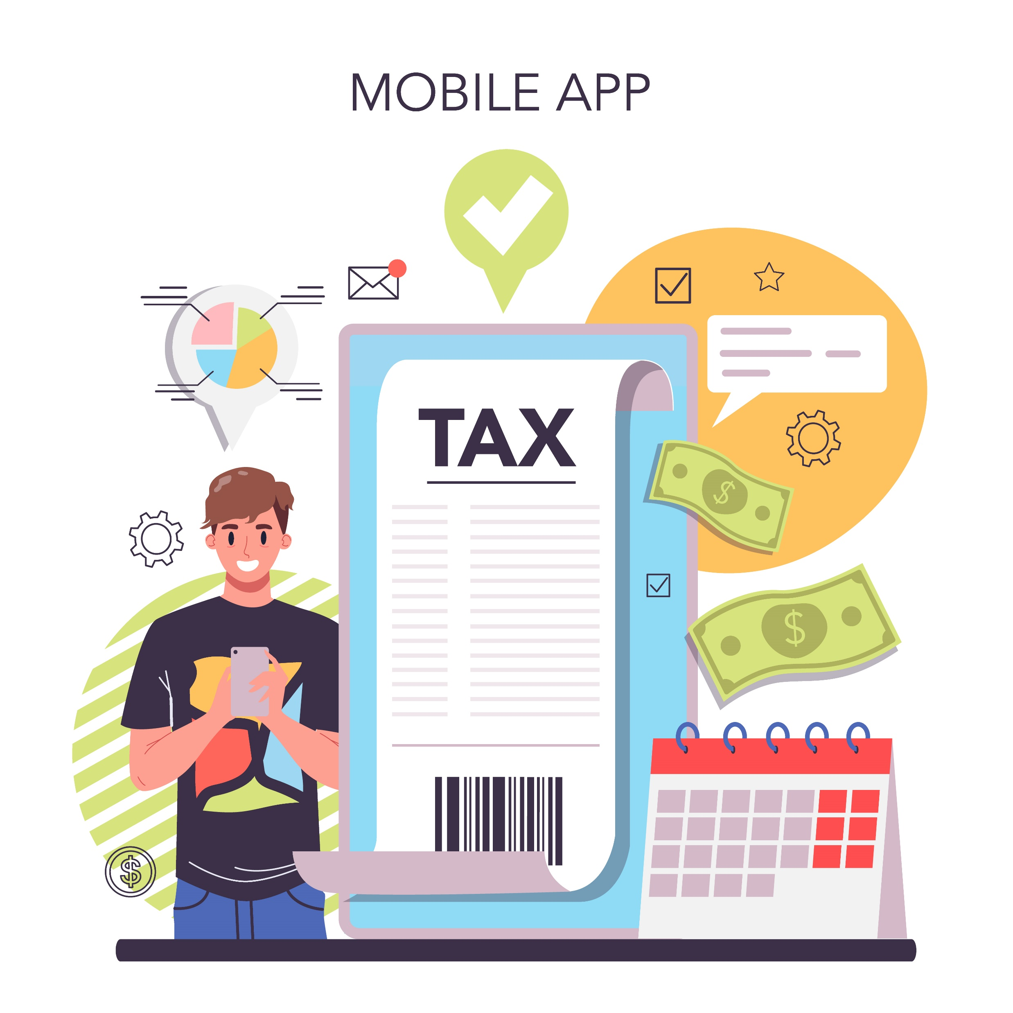



EXAMPLE OF A CAR, MOTORBIKE TRADING APPLICATION PLATFORM
Prepare electronic loan documents
Verify, issue digital certificate and sign contract/document
Bank staff check electronic documents
Agency issue invoice and certificate to declare tax
Sign credit contract, insurance/debit certificate with bank
Bank disbursement. Customer signs receipt record and receives vehicle
Police department check credit contract when vehicle is used

Slide 8

GOPAPERLESS
SUBSYSTEM

Slide 9

eRequest
eFlow
GOPAPERLESS SUBSYSTEM
eAnalysis
eProcess
eID
Virtual Collaboration
GOPAPERLESS
eBilling
eRegistry
eWriter
eAccount
eNotary

Slide 10
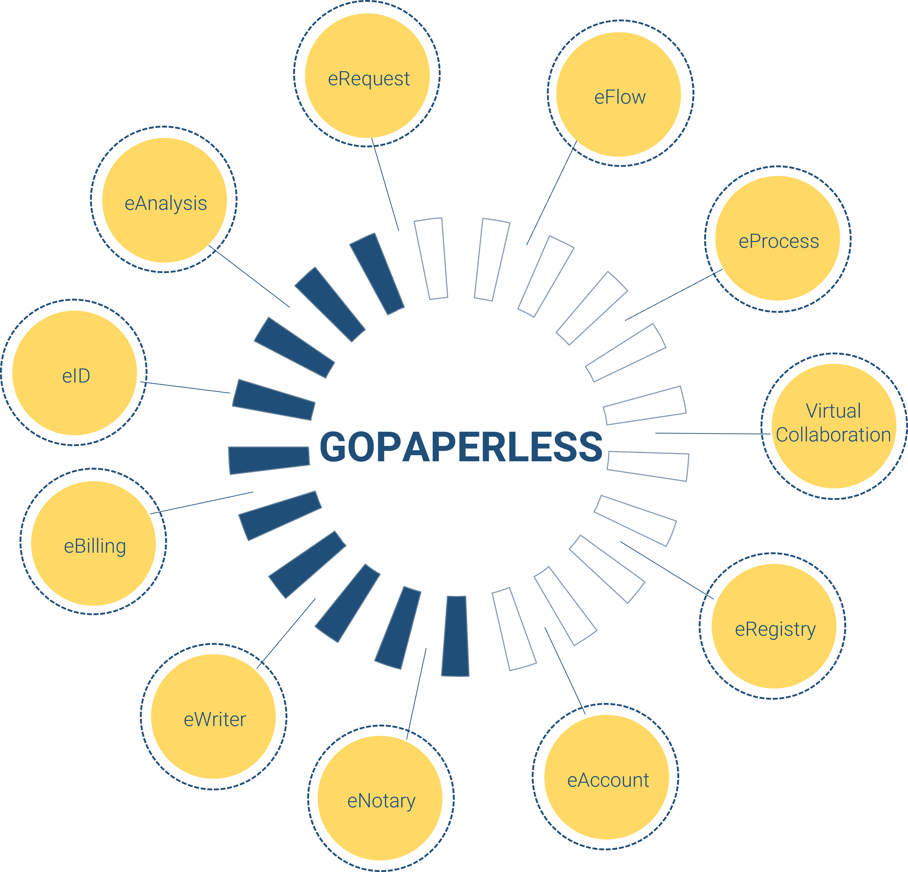
FULL PROCESS SIGNING PLATFORM
eAccount: Centralized account management subsystem
eRegistry: Service registration subsystem
eRequest: Ticket, ticket status management subsystem
eFlow: Subsystem for creating eForm and configuring workflow
eProcess: Subsystem for linking and publishing workflows
eID: Citizen’s identity information management subsystem
eNotary: Electronic notary subsystem
Virtual collaboration: Virtual collaboration module, allowing online contract negotiation, meetings, calls, chat
eAnalysis: Statistical analysis subsystem provides reports related to fields on the system
eBilling: Billing management subsystem
eWriter: Subsystem for editing and creating variables for documents with the purpose of exporting to another system to get the corresponding data variables

Slide 11





MOBILE-ID TECHNOLOGIES & SERVICES JOINT STOCK COMPANY
19 Dang Tien Dong street, An Phu ward, Thu Duc City, Ho Chi Minh City
028 3636 6015
info@mobile-id.vn

